Slide 1
Super Type –Sub Type Assignment Solution Conceptual and Logical Models
Khubaib Ahmed

Slide 2
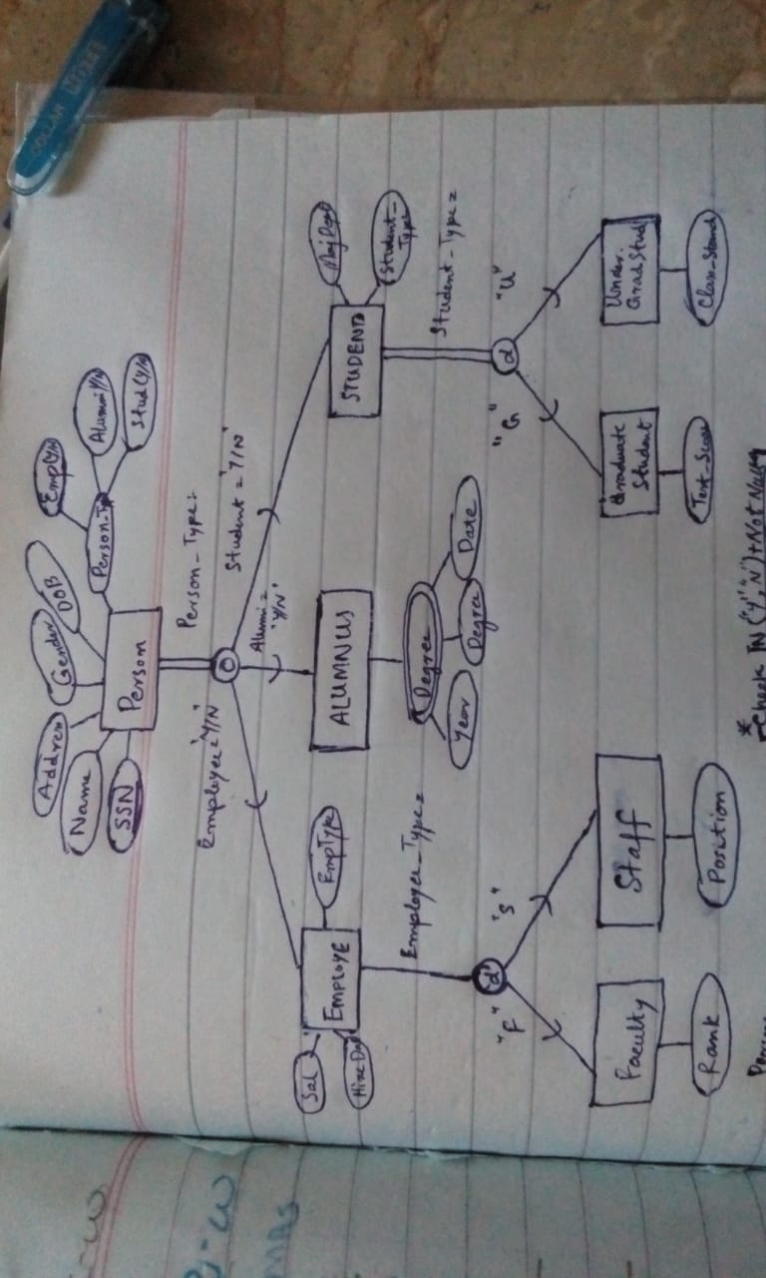

Slide 3
